Slide 1
Cross Bear!
From a problem posed at the
Kath Cross Special Event
at ATM Conference 2016

Slide 2
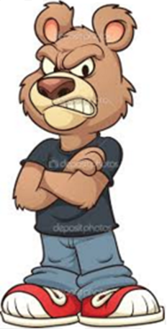

Cross Bear!
Daddy Bear, Mummy Bear and Baby Bear sit down to eat three identical bowls of porridge.
They begin eating together but their table manners are shocking and they will start to eat each other’s porridge once they have finished their own!
Daddy Bear finishes his porridge in 170 seconds and then starts eating from Mummy Bear’s bowl.
After 34 seconds Mummy Bear’s bowl is empty and so Daddy Bear and Mummy Bear start eating from Baby Bear’s bowl.
In a further 51 seconds it is all over.
What fraction of a full bowl of porridge did Baby Bear manage to eat?
How long would it take Baby Bear to finish a bowl of porridge “unaided”?

Slide 3
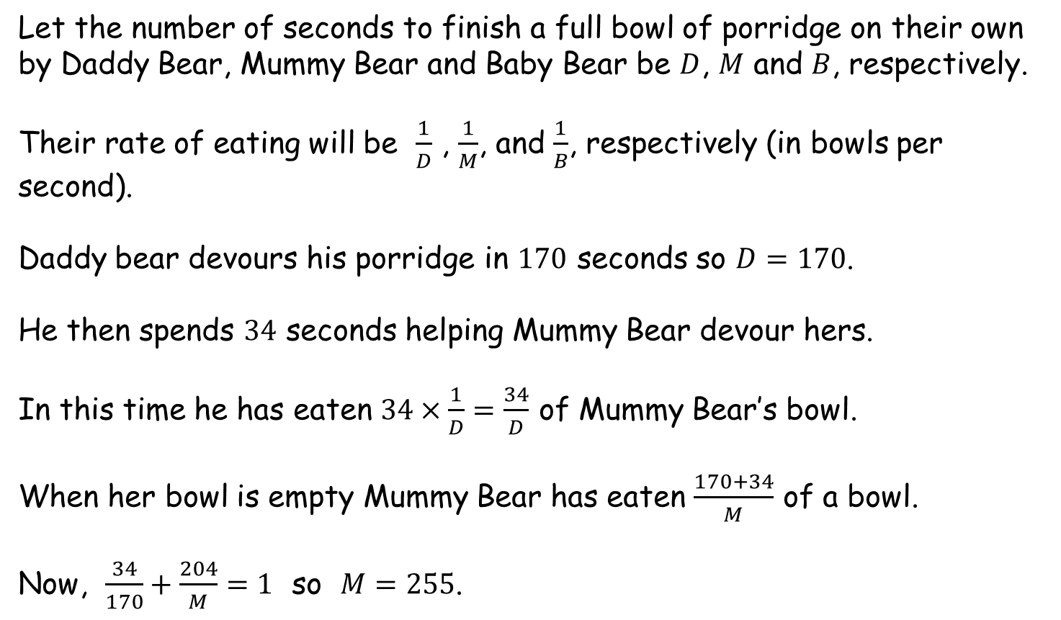
Cross Bear!
Let the number of seconds to finish a full bowl of porridge on their own by Daddy Bear, Mummy Bear and Baby Bear be $D$, $M$ and $B$, respectively.
Their rate of eating will be $\frac{1}{D}$ , $\frac{1}{M}$, and $\frac{1}{B}$, respectively (in bowls per second).
Daddy bear devours his porridge in $170$ seconds so $D=170$.
He then spends $34$ seconds helping Mummy Bear devour hers.
In this time he has eaten $34×\frac{1}{D}=\frac{34}{D}$ of Mummy Bear’s bowl.
When her bowl is empty Mummy Bear has eaten $\frac{170+34}{M}$ of a bowl.
Now, $\frac{34}{170}+\frac{204}{M}=1$ so $M=255$.

Slide 4
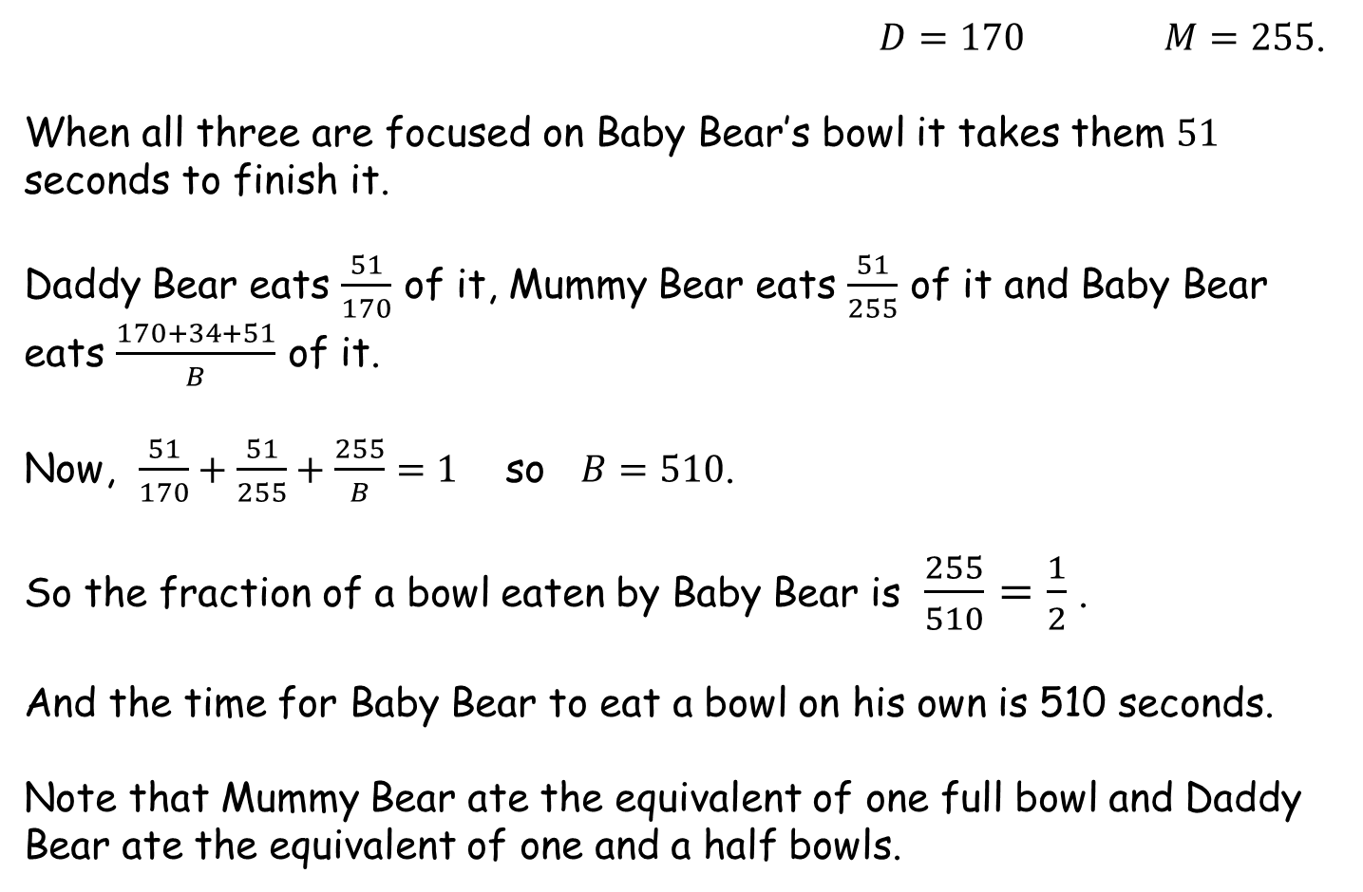
Cross Bear!
$D=170$ $M=255$.
When all three are focused on Baby Bear’s bowl it takes them $51$ seconds to finish it.
Daddy Bear eats $\frac{51}{170}$ of it, Mummy Bear eats $\frac{51}{255}$ of it and Baby Bear eats $\frac{170+34+51}{B}$ of it.
Now, $\frac{51}{170}+\frac{51}{255}+\frac{255}{B}=1$ so $B=510$.
So the fraction of a bowl eaten by Baby Bear is $\frac{255}{510}=\frac{1}{2}$ .
And the time for Baby Bear to eat a bowl on his own is 510 seconds.
Note that Mummy Bear ate the equivalent of one full bowl and Daddy Bear ate the equivalent of one and a half bowls.

Slide 6
Note to Teacher
The time taken by Baby Bear is 10 times the last time interval.
The amount of porridge Baby Bear eats is always ½ a bowl.
Baby Bear is always 3 times slower than Daddy Bear
Mummy Bear takes the total time given to eat 1 bowl (which is 1.5 times slower than Daddy Bear)

Slide 7
RESOURCES

Slide 8
Cross Bear!
SIC_41
Daddy Bear, Mummy Bear and Baby Bear sit down to eat three identical bowls of porridge.
They begin eating together but their table manners are shocking and they will start to eat each other’s porridge once they have finished their own!
Daddy Bear finishes his porridge in 10 seconds and then starts eating from Mummy Bear’s bowl.
After 2 seconds Mummy Bear’s bowl is empty and so Daddy Bear and Mummy Bear start eating from Baby Bear’s bowl.
In a further 3 seconds it is all over.
What fraction of a full bowl of porridge did Baby Bear manage to eat?
How long would it take Baby Bear to finish a bowl of porridge “unaided”?

Slide 9
Cross Bear!
SIC_41
Daddy Bear, Mummy Bear and Baby Bear sit down to eat three identical bowls of porridge.
They begin eating together but their table manners are shocking and they will start to eat each other’s porridge once they have finished their own!
Daddy Bear finishes his porridge in 20 seconds and then starts eating from Mummy Bear’s bowl.
After 4 seconds Mummy Bear’s bowl is empty and so Daddy Bear and Mummy Bear start eating from Baby Bear’s bowl.
In a further 6 seconds it is all over.
What fraction of a full bowl of porridge did Baby Bear manage to eat?
How long would it take Baby Bear to finish a bowl of porridge “unaided”?

Slide 10
Cross Bear!
SIC_41
Daddy Bear, Mummy Bear and Baby Bear sit down to eat three identical bowls of porridge.
They begin eating together but their table manners are shocking and they will start to eat each other’s porridge once they have finished their own!
Daddy Bear finishes his porridge in 30 seconds and then starts eating from Mummy Bear’s bowl.
After 6 seconds Mummy Bear’s bowl is empty and so Daddy Bear and Mummy Bear start eating from Baby Bear’s bowl.
In a further 9 seconds it is all over.
What fraction of a full bowl of porridge did Baby Bear manage to eat?
How long would it take Baby Bear to finish a bowl of porridge “unaided”?

Slide 11
Cross Bear!
SIC_41
Daddy Bear, Mummy Bear and Baby Bear sit down to eat three identical bowls of porridge.
They begin eating together but their table manners are shocking and they will start to eat each other’s porridge once they have finished their own!
Daddy Bear finishes his porridge in 40 seconds and then starts eating from Mummy Bear’s bowl.
After 8 seconds Mummy Bear’s bowl is empty and so Daddy Bear and Mummy Bear start eating from Baby Bear’s bowl.
In a further 12 seconds it is all over.
What fraction of a full bowl of porridge did Baby Bear manage to eat?
How long would it take Baby Bear to finish a bowl of porridge “unaided”?

Slide 12
Cross Bear!
SIC_41
Daddy Bear, Mummy Bear and Baby Bear sit down to eat three identical bowls of porridge.
They begin eating together but their table manners are shocking and they will start to eat each other’s porridge once they have finished their own!
Daddy Bear finishes his porridge in 50 seconds and then starts eating from Mummy Bear’s bowl.
After 10 seconds Mummy Bear’s bowl is empty and so Daddy Bear and Mummy Bear start eating from Baby Bear’s bowl.
In a further 15 seconds it is all over.
What fraction of a full bowl of porridge did Baby Bear manage to eat?
How long would it take Baby Bear to finish a bowl of porridge “unaided”?

Slide 13
Cross Bear!
SIC_41
Daddy Bear, Mummy Bear and Baby Bear sit down to eat three identical bowls of porridge.
They begin eating together but their table manners are shocking and they will start to eat each other’s porridge once they have finished their own!
Daddy Bear finishes his porridge in 60 seconds and then starts eating from Mummy Bear’s bowl.
After 12 seconds Mummy Bear’s bowl is empty and so Daddy Bear and Mummy Bear start eating from Baby Bear’s bowl.
In a further 18 seconds it is all over.
What fraction of a full bowl of porridge did Baby Bear manage to eat?
How long would it take Baby Bear to finish a bowl of porridge “unaided”?

Slide 14
Cross Bear!
SIC_41
Daddy Bear, Mummy Bear and Baby Bear sit down to eat three identical bowls of porridge.
They begin eating together but their table manners are shocking and they will start to eat each other’s porridge once they have finished their own!
Daddy Bear finishes his porridge in 70 seconds and then starts eating from Mummy Bear’s bowl.
After 14 seconds Mummy Bear’s bowl is empty and so Daddy Bear and Mummy Bear start eating from Baby Bear’s bowl.
In a further 21 seconds it is all over.
What fraction of a full bowl of porridge did Baby Bear manage to eat?
How long would it take Baby Bear to finish a bowl of porridge “unaided”?

Slide 15
Cross Bear!
SIC_41
Daddy Bear, Mummy Bear and Baby Bear sit down to eat three identical bowls of porridge.
They begin eating together but their table manners are shocking and they will start to eat each other’s porridge once they have finished their own!
Daddy Bear finishes his porridge in 80 seconds and then starts eating from Mummy Bear’s bowl.
After 16 seconds Mummy Bear’s bowl is empty and so Daddy Bear and Mummy Bear start eating from Baby Bear’s bowl.
In a further 24 seconds it is all over.
What fraction of a full bowl of porridge did Baby Bear manage to eat?
How long would it take Baby Bear to finish a bowl of porridge “unaided”?

Slide 16
Cross Bear!
SIC_41
Daddy Bear, Mummy Bear and Baby Bear sit down to eat three identical bowls of porridge.
They begin eating together but their table manners are shocking and they will start to eat each other’s porridge once they have finished their own!
Daddy Bear finishes his porridge in 90 seconds and then starts eating from Mummy Bear’s bowl.
After 18 seconds Mummy Bear’s bowl is empty and so Daddy Bear and Mummy Bear start eating from Baby Bear’s bowl.
In a further 27 seconds it is all over.
What fraction of a full bowl of porridge did Baby Bear manage to eat?
How long would it take Baby Bear to finish a bowl of porridge “unaided”?

Slide 17
Cross Bear!
SIC_41
Daddy Bear, Mummy Bear and Baby Bear sit down to eat three identical bowls of porridge.
They begin eating together but their table manners are shocking and they will start to eat each other’s porridge once they have finished their own!
Daddy Bear finishes his porridge in 100 seconds and then starts eating from Mummy Bear’s bowl.
After 20 seconds Mummy Bear’s bowl is empty and so Daddy Bear and Mummy Bear start eating from Baby Bear’s bowl.
In a further 30 seconds it is all over.
What fraction of a full bowl of porridge did Baby Bear manage to eat?
How long would it take Baby Bear to finish a bowl of porridge “unaided”?

Slide 18
Cross Bear!
SIC_41
Daddy Bear, Mummy Bear and Baby Bear sit down to eat three identical bowls of porridge.
They begin eating together but their table manners are shocking and they will start to eat each other’s porridge once they have finished their own!
Daddy Bear finishes his porridge in 110 seconds and then starts eating from Mummy Bear’s bowl.
After 22 seconds Mummy Bear’s bowl is empty and so Daddy Bear and Mummy Bear start eating from Baby Bear’s bowl.
In a further 33 seconds it is all over.
What fraction of a full bowl of porridge did Baby Bear manage to eat?
How long would it take Baby Bear to finish a bowl of porridge “unaided”?

Slide 19
Cross Bear!
SIC_41
Daddy Bear, Mummy Bear and Baby Bear sit down to eat three identical bowls of porridge.
They begin eating together but their table manners are shocking and they will start to eat each other’s porridge once they have finished their own!
Daddy Bear finishes his porridge in 120 seconds and then starts eating from Mummy Bear’s bowl.
After 24 seconds Mummy Bear’s bowl is empty and so Daddy Bear and Mummy Bear start eating from Baby Bear’s bowl.
In a further 36 seconds it is all over.
What fraction of a full bowl of porridge did Baby Bear manage to eat?
How long would it take Baby Bear to finish a bowl of porridge “unaided”?

Slide 20
Cross Bear!
SIC_41
Daddy Bear, Mummy Bear and Baby Bear sit down to eat three identical bowls of porridge.
They begin eating together but their table manners are shocking and they will start to eat each other’s porridge once they have finished their own!
Daddy Bear finishes his porridge in 130 seconds and then starts eating from Mummy Bear’s bowl.
After 26 seconds Mummy Bear’s bowl is empty and so Daddy Bear and Mummy Bear start eating from Baby Bear’s bowl.
In a further 39 seconds it is all over.
What fraction of a full bowl of porridge did Baby Bear manage to eat?
How long would it take Baby Bear to finish a bowl of porridge “unaided”?

Slide 21
Cross Bear!
SIC_41
Daddy Bear, Mummy Bear and Baby Bear sit down to eat three identical bowls of porridge.
They begin eating together but their table manners are shocking and they will start to eat each other’s porridge once they have finished their own!
Daddy Bear finishes his porridge in 140 seconds and then starts eating from Mummy Bear’s bowl.
After 28 seconds Mummy Bear’s bowl is empty and so Daddy Bear and Mummy Bear start eating from Baby Bear’s bowl.
In a further 42 seconds it is all over.
What fraction of a full bowl of porridge did Baby Bear manage to eat?
How long would it take Baby Bear to finish a bowl of porridge “unaided”?

Slide 22
Cross Bear!
SIC_41
Daddy Bear, Mummy Bear and Baby Bear sit down to eat three identical bowls of porridge.
They begin eating together but their table manners are shocking and they will start to eat each other’s porridge once they have finished their own!
Daddy Bear finishes his porridge in 150 seconds and then starts eating from Mummy Bear’s bowl.
After 30 seconds Mummy Bear’s bowl is empty and so Daddy Bear and Mummy Bear start eating from Baby Bear’s bowl.
In a further 45 seconds it is all over.
What fraction of a full bowl of porridge did Baby Bear manage to eat?
How long would it take Baby Bear to finish a bowl of porridge “unaided”?

Slide 23
Cross Bear!
SIC_41
Daddy Bear, Mummy Bear and Baby Bear sit down to eat three identical bowls of porridge.
They begin eating together but their table manners are shocking and they will start to eat each other’s porridge once they have finished their own!
Daddy Bear finishes his porridge in 160 seconds and then starts eating from Mummy Bear’s bowl.
After 32 seconds Mummy Bear’s bowl is empty and so Daddy Bear and Mummy Bear start eating from Baby Bear’s bowl.
In a further 48 seconds it is all over.
What fraction of a full bowl of porridge did Baby Bear manage to eat?
How long would it take Baby Bear to finish a bowl of porridge “unaided”?

